Slide 1



Kotlin Control Statements & Android Views

Slide 2
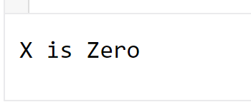
Control statements - if
if (cond) { statements } | if (cond) statement
Condition is a Boolean ( return true or false).
It supports logical operators such as ==, !=, >,<,<=,>=
if has to be small letters.
IF , If, iF don’t work.
{} is optional if we have one statement.
fun main() {
val x : Int=0;
if (x==0)
{
println("X is Zero")
}
}

Slide 3
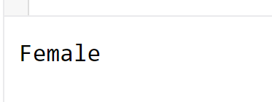
Control statements – if .. else
if (cond) { statements block1 } else {statements block2}
The case of having cond is true, statement block1 will be performed.
The case of having cond is false, statement block2 will be performed.
Else has to be small letters.
fun main() {
val x : String = "f";
if (x=="f")
println("Female")
else
println("Male")
}

Slide 4
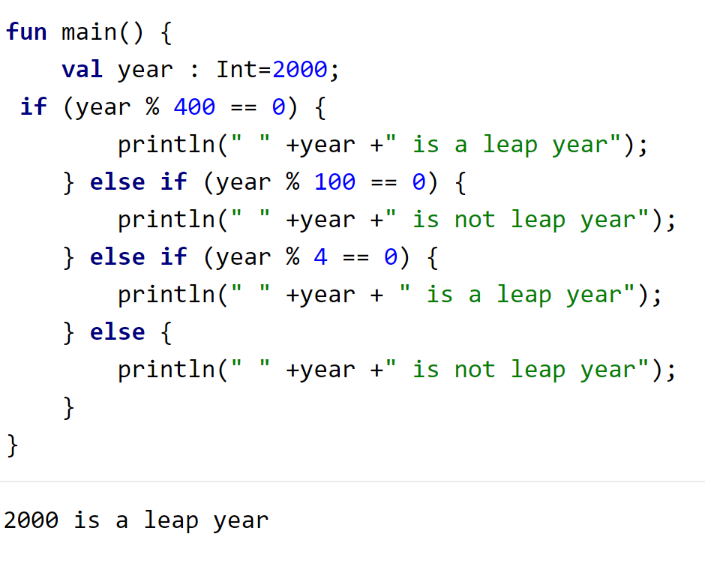
Control statements – if .. else if ..else
if (cond) { statements block1 } else if (cond 2){statements block2 } else {statements block3}
You can as many condition you need.
The first if must be if. The rest must be else if.
Else will take care of the conditions that were not matched in if, and else ifs.

Slide 5
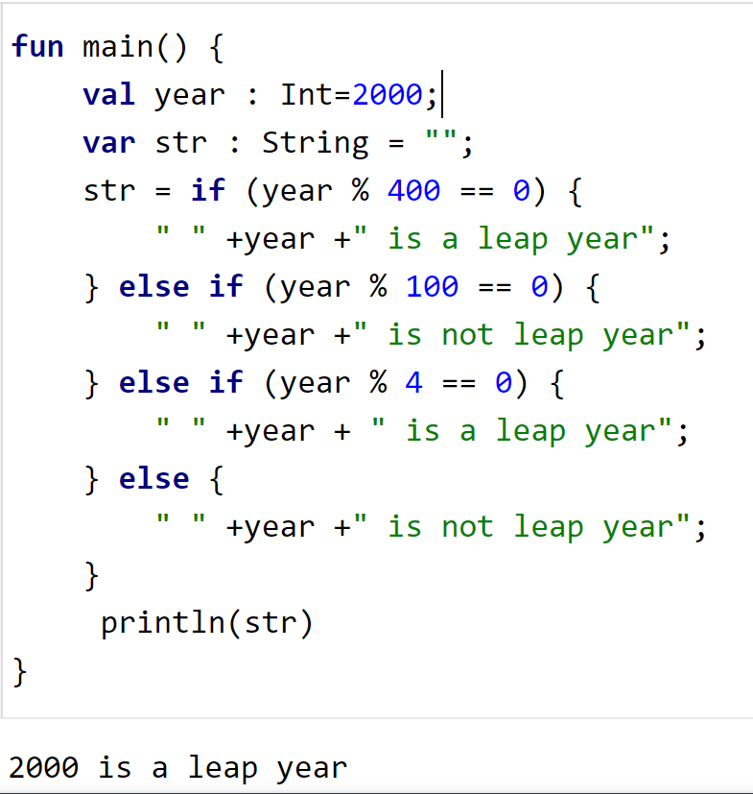
Control statements – if returns value
var x…
x = if statement
The last statement in the statement block can be the return value of the if, else if, else.

Slide 6
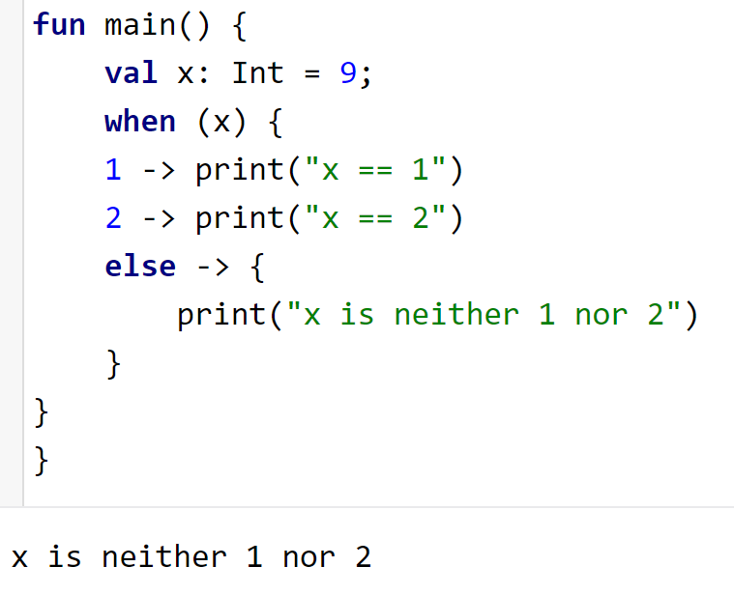
Control statements – when statement
when (variable) { value1->statement1
value2->statement2
else->statement3}
When is the equivalent of switch statement in c-like programing languages.
Branch starts after the value -> then followed by a statement.
When there is no match with the value of all branches, the statement in else will fire.

Slide 7
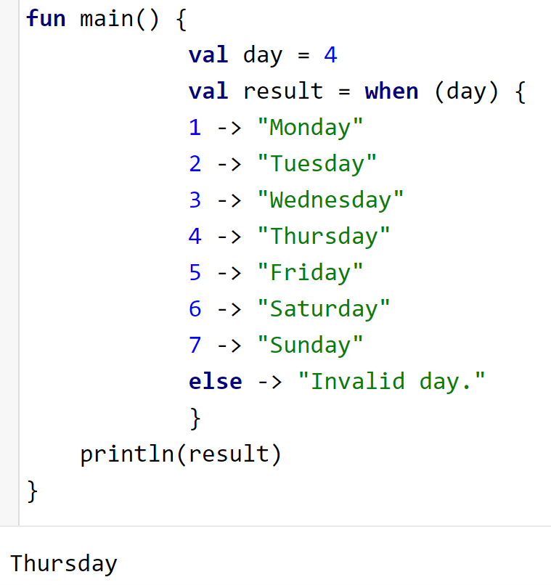
Control statements – when returns value
When is the equivalent of switch statement in c-like programing languages.
the value of variable day in the example is compared with each branch if the when.

Slide 8
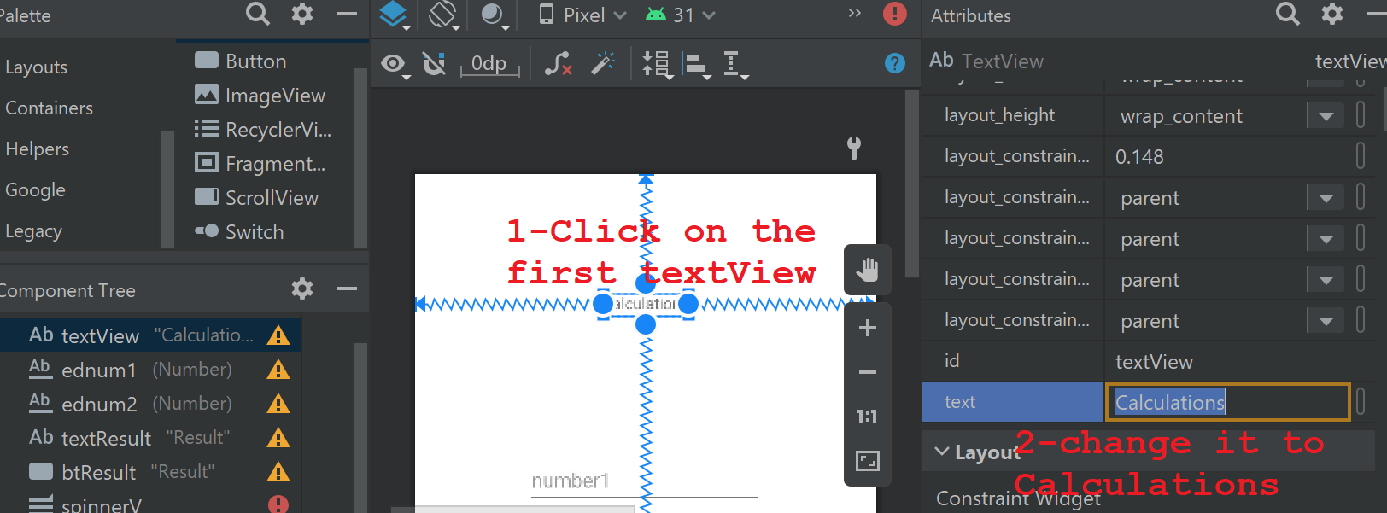
Change Sum2Num project to be “Calculations”

Slide 9
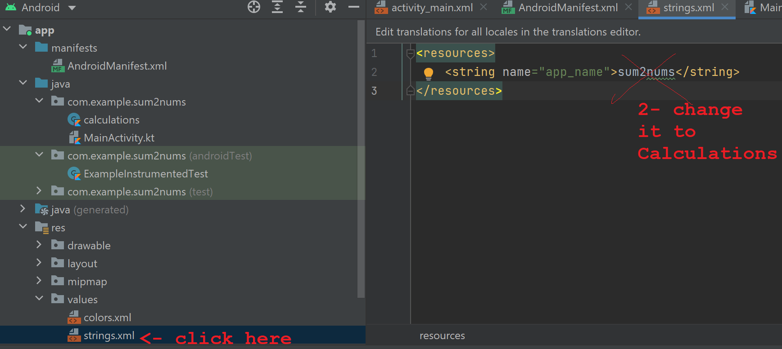
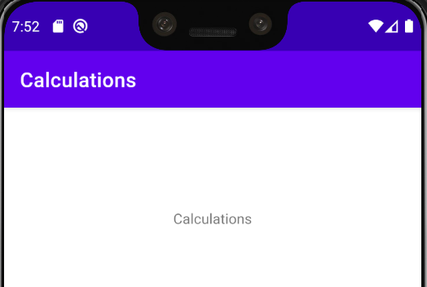
Change the app name

Slide 10
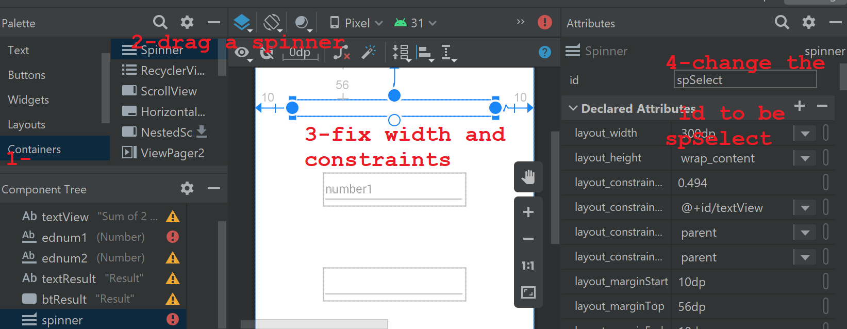
Change Sum2Num project to be “Calculations”

Slide 11
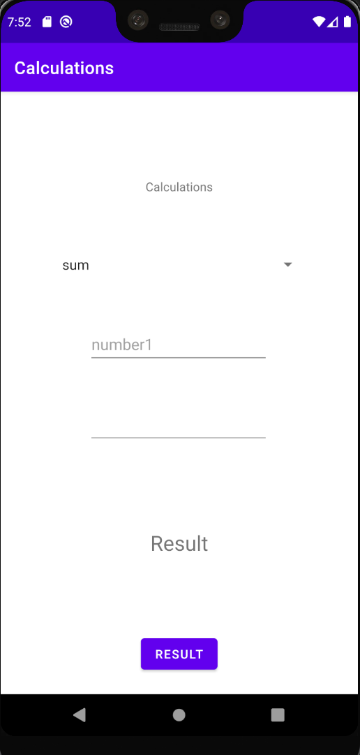
Add multiplication function
// remember this is in MainActivity.kt
public fun sum(a: Int, b: Int): Int {
return a+b
}
public fun multiply(a: Int, b: Int): Int {
return a*b
}

Slide 12
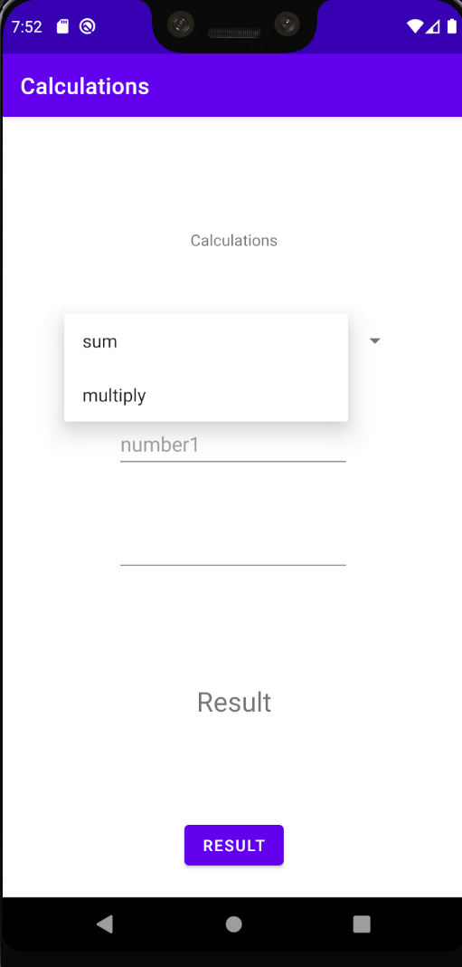
Create the Spinner item
Under this line add the remaining lines
val resultTV: TextView = findViewById(R.id.textResult) //global variable var flag : String = "sum" //here .. create a spinner items (options) val spinnerVal : Spinner = findViewById(R.id.spinnerV) var options = arrayOf("sum","multiply") spinnerVal.adapter = ArrayAdapter<String>(this,android.R.layout.simple_list_item_1,options )
Set the spinner adaptor to read from the array named as options

Slide 13
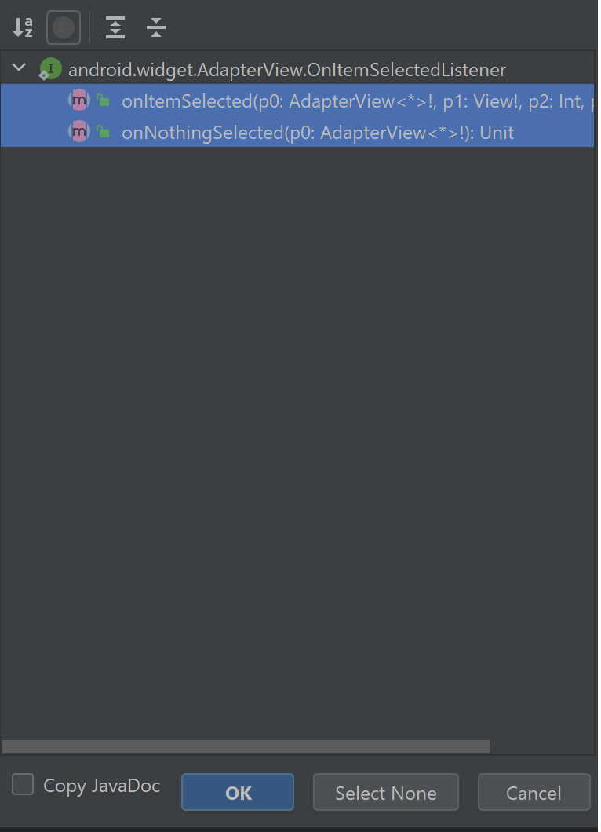
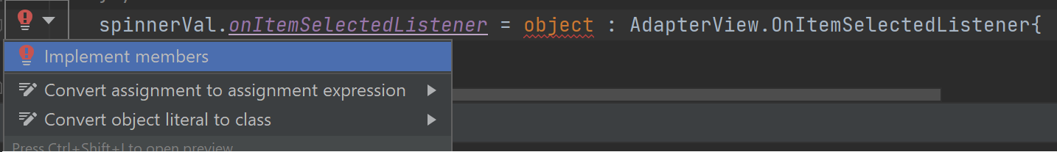
Add onItemSelectedListener to the spinner
Under the previous code you’ve just added, add the following line:
spinnerVal.onItemSelectedListener = object : AdapterView.OnItemSelectedListener{
It will show a red line under object, hover it by mouse to get the red bulb, click on it, then click on implement members
Finally select both and click ok

Slide 14
Listener keeps the selected option
spinnerVal.onItemSelectedListener = object : AdapterView.OnItemSelectedListener{ override fun onItemSelected(p0: AdapterView<*>?, p1: View?, p2: Int, p3: Long) { flag = options.get(p2) //p2 is the index of selected item } override fun onNothingSelected(p0: AdapterView<*>?) { TODO("Not yet implemented") } }
Save the selected position (p2 argument) in the global flag variable, this will assign either “sum” or “multiply” to flag

Slide 15
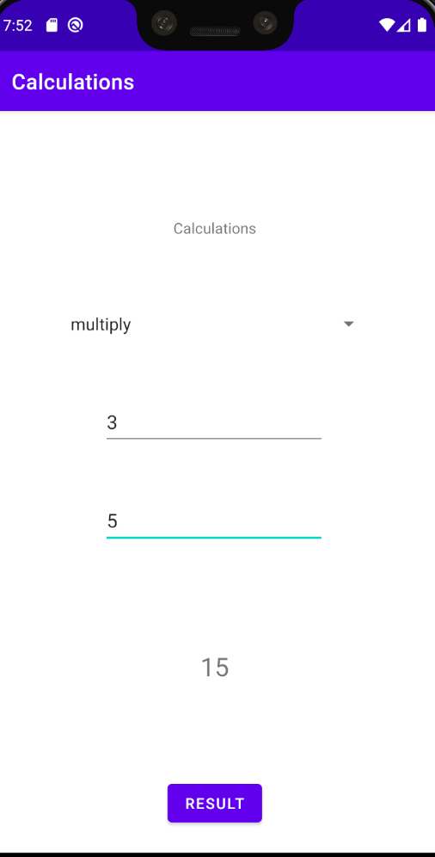
Change the button listener to switch the functions
button.setOnClickListener{ view -> //code here var x: Int = edtxt1.text.toString().toInt(); var y: Int = edtxt2.text.toString().toInt(); if(flag =="sum") resultTV.text = sum(x,y).toString(); else resultTV.text = multiply(x,y).toString(); }

Slide 16
The full text MainActivity.kt
package com.example.sum2nums
import androidx.appcompat.app.AppCompatActivity
import android.os.Bundle
import android.text.Editable
import android.text.TextUtils
import android.text.TextWatcher
import android.view.View
import android.widget.*
import androidx.core.widget.doOnTextChanged
import com.google.android.material.navigation.NavigationBarView
class MainActivity : AppCompatActivity() {
override fun onCreate(savedInstanceState: Bundle?) {
super.onCreate(savedInstanceState)
setContentView(R.layout.activity_main)
val button: Button = findViewById(R.id.btResult)
val edtxt1: EditText = findViewById(R.id.ednum1)
val edtxt2: EditText = findViewById(R.id.ednum2)
val resultTV: TextView = findViewById(R.id.textResult)
//global variable
var flag : String = "sum"
//here .. create a spinner items (options)
val spinnerVal : Spinner = findViewById(R.id.spinnerV)
var options = arrayOf("sum","multiply")
spinnerVal.adapter = ArrayAdapter<String>(this,android.R.layout.simple_list_item_1,options )
button.setOnClickListener{ view ->
//code here
var x: Int = edtxt1.text.toString().toInt();
var y: Int = edtxt2.text.toString().toInt();
if(flag =="sum")
resultTV.text = sum(x,y).toString();
else
resultTV.text = multiply(x,y).toString();
}
spinnerVal.onItemSelectedListener = object : AdapterView.OnItemSelectedListener{
override fun onItemSelected(p0: AdapterView<*>?, p1: View?, p2: Int, p3: Long) {
flag = options.get(p2) //p2 is the index of selected item
}
override fun onNothingSelected(p0: AdapterView<*>?) {
TODO("Not yet implemented")
}
}
}
}
public fun sum(a: Int, b: Int): Int {
return a+b
}
public fun multiply(a: Int, b: Int): Int {
return a*b
}

Slide 17

Activity_main.xml
<?xml version="1.0" encoding="utf-8"?> <androidx.constraintlayout.widget.ConstraintLayout xmlns:android="http://schemas.android.com/apk/res/android" xmlns:app="http://schemas.android.com/apk/res-auto" xmlns:tools="http://schemas.android.com/tools" android:layout_width="match_parent" android:layout_height="match_parent" tools:context=".MainActivity">
The main layout attributes can be also set from here, when you click on code button
<TextView android:id="@+id/textView" android:layout_width="wrap_content" android:layout_height="wrap_content" android:text="Calculations" app:layout_constraintBottom_toBottomOf="parent" app:layout_constraintLeft_toLeftOf="parent" app:layout_constraintRight_toRightOf="parent" app:layout_constraintTop_toTopOf="parent" app:layout_constraintVertical_bias="0.148" />
These are the attributes of the first TextView, noticed that we have changed the text attribute to be “Calculations” from the attributes menu, that was reflected here!!

Slide 18
Activity_main.xml
<EditText android:id="@+id/ednum1" android:layout_width="wrap_content" android:layout_height="wrap_content" android:layout_marginTop="44dp" android:ems="10" android:hint="number1" android:inputType="number" android:minHeight="48dp" app:layout_constraintEnd_toEndOf="parent" app:layout_constraintHorizontal_bias="0.497" app:layout_constraintStart_toStartOf="parent" app:layout_constraintTop_toBottomOf="@+id/spinnerV" />
<EditText android:id="@+id/ednum2" android:layout_width="wrap_content" android:layout_height="wrap_content" android:layout_marginTop="44dp" android:ems="10" android:inputType="number" android:minHeight="48dp" app:layout_constraintEnd_toEndOf="parent" app:layout_constraintHorizontal_bias="0.497" app:layout_constraintStart_toStartOf="parent" app:layout_constraintTop_toBottomOf="@+id/ednum1" tools:ignore="SpeakableTextPresentCheck" />
The 2 editTexts, notice their ids!
Try to notice: layout_constraintTop_toBottomOf

Slide 19
Activity_main.xml
<TextView android:id="@+id/textResult" android:layout_width="wrap_content" android:layout_height="wrap_content" android:layout_marginTop="96dp" android:text="Result" android:textSize="24sp" app:layout_constraintBottom_toBottomOf="parent" app:layout_constraintEnd_toEndOf="parent" app:layout_constraintStart_toStartOf="parent" app:layout_constraintTop_toBottomOf="@+id/ednum2" app:layout_constraintVertical_bias="0.0" />
The result TextView

Slide 20
Activity_main.xml
<Button android:id="@+id/btResult" android:layout_width="wrap_content" android:layout_height="wrap_content" android:layout_marginTop="88dp" android:text="Result" app:layout_constraintBottom_toBottomOf="parent" app:layout_constraintEnd_toEndOf="parent" app:layout_constraintStart_toStartOf="parent" app:layout_constraintTop_toBottomOf="@+id/textResult" app:layout_constraintVertical_bias="0.0" />
The button, try to change the text to be “ok” then run the app!

Slide 21
Activity_main.xml
<Spinner android:id="@+id/spinnerV" android:layout_width="300dp" android:layout_height="wrap_content" android:layout_marginStart="10dp" android:layout_marginTop="56dp" android:layout_marginEnd="10dp" app:layout_constraintEnd_toEndOf="parent" app:layout_constraintHorizontal_bias="0.494" app:layout_constraintStart_toStartOf="parent" app:layout_constraintTop_toBottomOf="@+id/textView" /> </androidx.constraintlayout.widget.ConstraintLayout>
The spinner is the last item? Why?
The end of the layout container

Slide 22
References
W3schools.com
https://kotlinlang.org/docs/classes.html

